Slide 1
Notes:
John Todd Ecological Design (JTED) is a Massachusetts-based sustainable water management company that designs and integrates natural systems for the treatment of wastewater and the remediation of degraded water bodies.

Slide 2
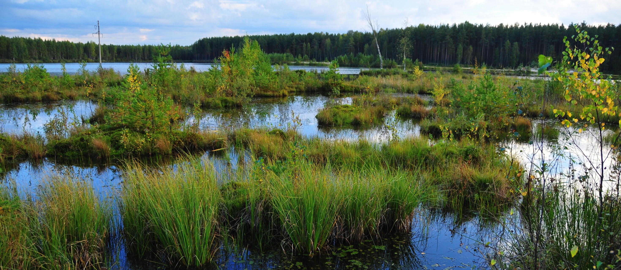
BIOLOGY
Wetland ecosystems cycle and purify water
Notes:
John Todd, the founder of John Todd Ecological Design (JTED), used his knowledge of ecosystems and looked into converting the “services,” like cleaning and purifying water, into sustainable technologies that could help solve challenges like wastewater treatment and remediation.

Slide 3
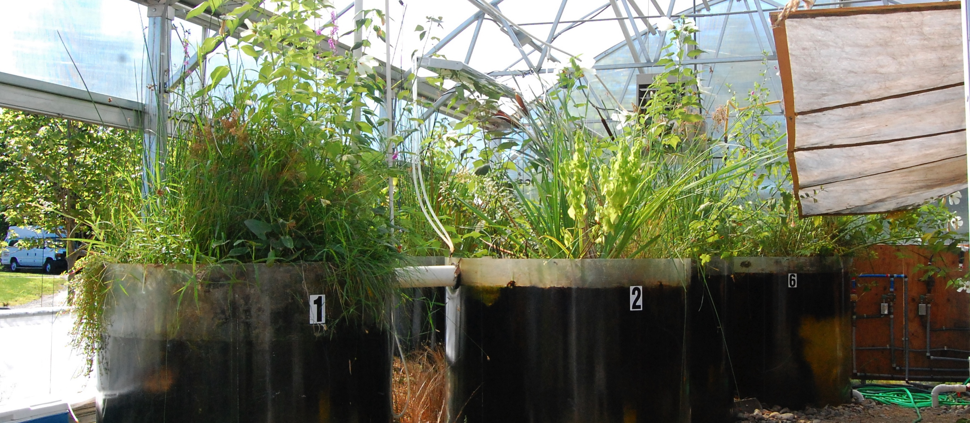
DESIGN
Eco-Machines mimic wetlands to produce clean water
Notes:
The designs are based on robust ecological systems in nature that effectively cycle nutrients and water. Harnessing biodiversity and natural processes in the Eco-MachineTM and Restorer systems allows JTED’s “living machines” to treat the most difficult contaminants and human waste streams, meeting and surpassing regulatory requirements.

Slide 4
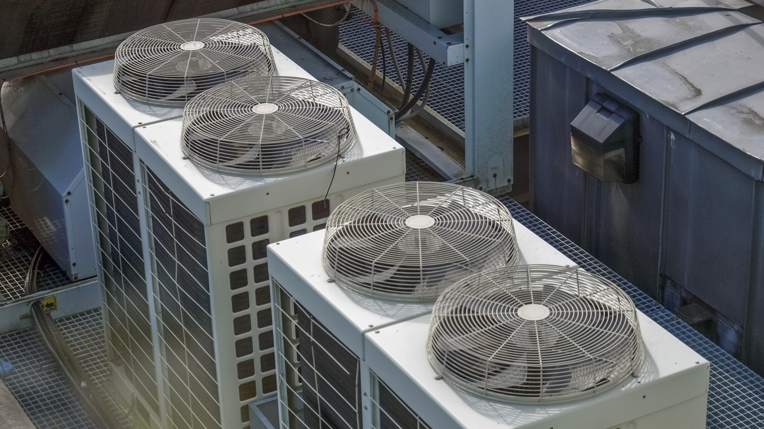
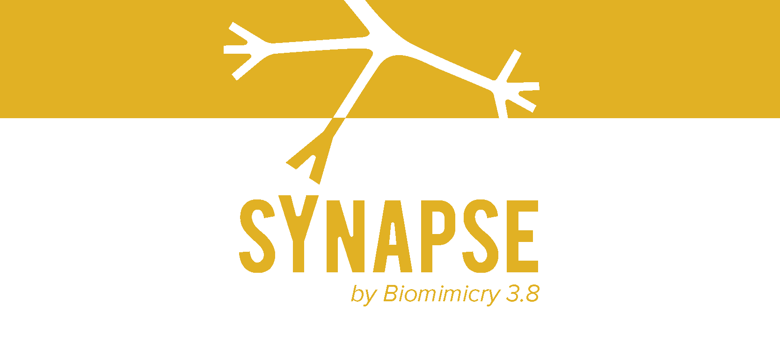
Biomimicry Case Study | John Todd Ecological Design
The commercialization story behind the wastewater treatment & water body remediation process
that mimics natural wetlands.
Discover more biomimicry solutions at Synapse.bio
Notes:
Visit Synapse.bio to learn more about this and other biomimicry case studies!

